Slide 1

INSTITUTE : UIE
DEPARTMENT : CSE
Bachelor of Engineering (Computer Science & Engineering)
Mobile Application Development(20CST-355)
TOPIC OF PRESENTATION:
What is a Web Service?, Web Services Languages, Formats, Creating an Example Web Service,
Prepared by:
Parveen Kumar Saini(E13339)
DISCOVER . LEARN . EMPOWER

Slide 2
Web Service Architecture

Slide 3
Table of Contents
What’s Web Service?
Web Service Model
Architecture Overview
SOAP
WSDL
UDDI
Conclusion

Slide 4
What’s Web Service?
“Software application identified by a URI, whose interfaces and bindings are capable of being defined, described, and discovered as XML artifacts” – W3C Web Services Architecture Requirements, Oct. 2002
“Programmable application logic accessible using Standard Internet Protocols…” – Microsoft
“An interface that describes a collection of operations that are network accessible through standardized XML messaging …” – IBM
“Software components that can be spontaneously discovered, combined, and recombined to provide a solution to the user’s problem/request … “ - SUN

Slide 5
Web Services: The Next Horizon for e-business
Allow companies to reduce the cost of doing e-business, to deploy solutions faster
Need a common program-to-program communications model
Allow heterogeneous applications to be integrated more rapidly, easily and less expensively
Facilitate deploying and providing access to business functions over the Web

Slide 6
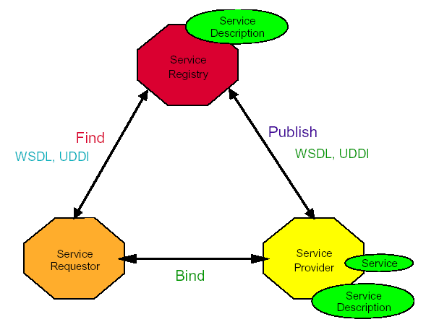
Web Service Model (1/3)

Slide 7
Web Service Model (2/3)
Roles in Web Service architecture
Service provider
Owner of the service
Platform that hosts access to the service
Service requestor
Business that requires certain functions to be satisfied
Application looking for and invoking an interaction with a service
Service registry
Searchable registry of service descriptions where service providers publish their service descriptions

Slide 8
Web Service Model (3/3)
Operations in a Web Service Architecture
Publish
Service descriptions need to be published in order for service requestor to find them
Find
Service requestor retrieves a service description directly or queries the service registry for the service required
Bind
Service requestor invokes or initiates an interaction with the service at runtime

Slide 9
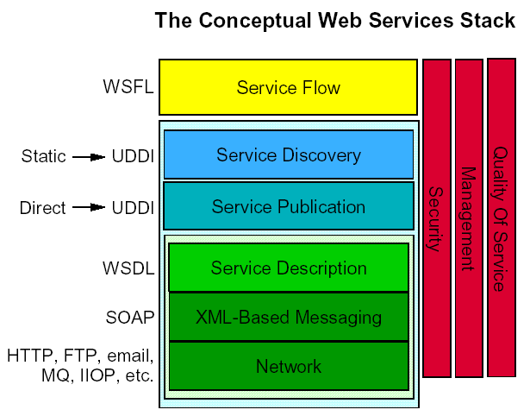
Web Service Stack

Slide 10
SOAP: Simple Object Access Protocol
What is SOAP?
SOAP is a communication protocol
SOAP is for communication between applications
SOAP is a format for sending messages
SOAP is designed to communicate via Internet
SOAP is platform independent
SOAP is language independent
SOAP is based on XML
SOAP is simple and extensible
SOAP will be developed as a W3C standard

Slide 11
SOAP: Simple Object Access Protocol
SOAP 1.0: Microsoft, Userland, DevelopMentor
Specific to COM and HTTP
SOAP 1.1: includes contributions from IBM and Lotus
Substitutable transport binding (not just HTTP)
Substitutable language binding (e.g. Java)
Substitutable data encoding
Completely vendor-neutral
Independent of: programming language, object model, operating system, or platform
SOAP 1.2: current working draft from w3.org “XML Protocol” working group

Slide 12
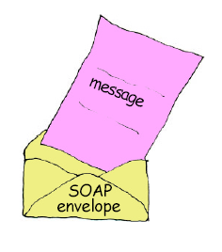
SOAP Message Structure
Application-specific message vocabulary
Request and Response messages
Request invokes a method on a remote object
Response returns result of running the method
SOAP specification defines an “envelop”
“envelop” wraps the message itself
Message is a different vocabulary
Namespace prefix is used to distinguish the two parts
SOAP Envelop vocabulary

Slide 13
SOAP Request Message
SOAP Envelope
Namespace
<?xml version="1.0"?>
<soap:Envelope
xmlns:soap="http://www.w3.org/2001/12/soap-envelope"
soap:encodingStyle="http://www.w3.org/2001/12/soap-encoding">
<soap:Body xmlns:m="http://www.stock.org/stock">
</soap:Body>
</soap:Envelope>
<m:GetStockPrice>
<m:StockName>IBM</m:StockName>
</m:GetStockPrice>
Message
SOAP Envelope
Message
Namespace

Slide 14
SOAP Response Message
<?xml version="1.0"?>
<soap:Envelope
xmlns:soap="http://www.w3.org/2001/12/soap-envelope"
soap:encodingStyle="http://www.w3.org/2001/12/soap-encoding">
<soap:Body xmlns:m="http://www.stock.org/stock">
</soap:Body>
</soap:Envelope>
<m:GetStockPriceResponse>
<m:Price>34.5</m:Price>
</m:GetStockPriceResponse>
Message
Result
returned in
Body
SOAP Envelope

Slide 15
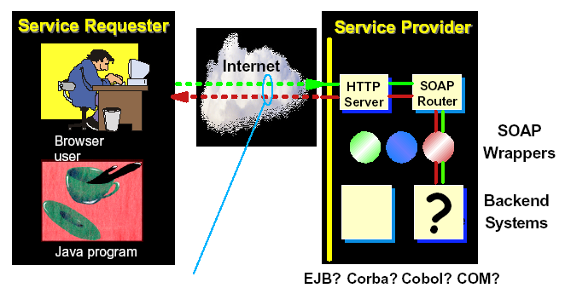
Simple standard XML Message
SOAP hides the technical choices and implementation details from both parties

Slide 16
Why SOAP?
Other distributed technologies failed on the Internet
Unix RPC – requires binary-compatible Unix implementations at each endpoint
CORBA – requires compatible ORBs
RMI – requires Java at each endpoint
DCOM – requires Windows at each endpoint
SOAP is the platform-neutral choice
Simply an XML wire format
Places no restrictions on the endpoint implementation technology choices

Slide 17
SOAP Usage Models
RPC-like message exchange
Request message bundles up method name and parameters
Response message contains method return values
However, it isn’t required by SOAP
SOAP specification allows any kind of body content
Can be XML documents of any type
Example:
Send a purchase order document to the inbox of B2B partner
Expect to receive shipping and exceptions report as response

Slide 18
Web Services Description Language
What is WSDL?
WSDL is written in XML
WSDL is an XML document
WSDL is used to describe Web services
WSDL is also used to locate Web services
WSDL is not yet a W3C standard
Operational information about the service
Location of the service
Service interface
Implementation details for the service interface

Slide 19
WSDL Document Structure (1/2)
<portType> element
Defines a web service, the operations that can be performed, and the messages that are involved
<message> element
Defines the data elements of an operation
consists of one or more parts.
The parts can be compared to the parameters of a function call in a traditional programming language

Slide 20
WSDL Document Structure (2/2)
<types> element
Defines the data type that are used by the web service
For maximum platform neutrality, WSDL uses XML Schema syntax to define data types
<binding> element
Defines the message format and communication protocols used by the web service

Slide 21
Universal Description, Discovery and Integration (UDDI)
What is UDDI?
Directory service where businesses can register and search for Web services
Directory for storing information about web services
Directory of web service interfaces described by WSDL
UDDI communicates via SOAP
What is UDDI Based On?
Uses W3C Internet standards such as XML, HTTP, and DNS protocols
UDDI uses WSDL to describe interfaces to web services

Slide 22
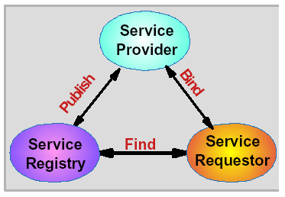
UDDI Roles and Operations
Service Registry
Provides support for publishing and locating services
Like telephone yellow pages
Service Provider
Provides e-business services
Publishes these services through a registry
Service requestor
Finds required services via the Service Broker
Binds to services via Service Provider

Slide 23
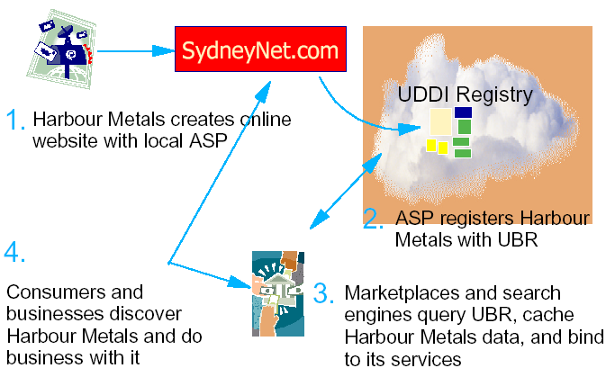
How can UDDI be Used?

Slide 24
UDDI Benefits
Making it possible to discover the right business from the millions currently online
Defining how to enable commerce once the preferred business is discovered
Reaching new customers and increasing access to current customers
Expanding offerings and extending market reach

Slide 25
Types of UDDI nodes (1/3)
Internal Enterprise Application UDDI node
Web Services for use within a company for internal enterprise application integration
The scope can be single application, departmental, corporate
Sit behind the firewall
Allow the service providers more control over their service registry and its accessibility

Slide 26
Types of UDDI nodes (2/3)
Portal UDDI node
Web Services published by a company for external partners to find and use
Runs outside the service provider’s firewall
Contains only those service descriptions that a company wishes to provide to service requestors from external partners
Partner catalog UDDI node
Web services to be used by a particular company
Runs behind the firewall
Contains only approved, tested and valid Web service descriptions for legitimate business partners

Slide 27
Types of UDDI nodes (3/3)
E-Marketplace UDDI node
Web Services that the service provider intends to compete for requestors’ business with other Web Services
Hosted by an industry standards organization or consortium
Contains service descriptions from businesses in a particular industry

Slide 29
THANK YOU
For queries
Email: parveen.e13339@cumail.in

